Slide 1

K S INSTITUTE OF TECHNOLOGY
Bengaluru-560109
Forest Fire Susceptibility using Neural Network
Guided by:
Mr. Kumar K
Asst.Prof, CSE department
Batch 31:
Amaravathi M Chandan Kumar Likhitha N Nandini J K
1KS18CS002 1KS18CS016 1KS18CS039 1KS18CS056

Slide 2
OVERVIEW
Proposed a spatial prediction model for forest fire susceptibility using CNN
Made use of CNN deep learning algorithm to predict the forest fire susceptibility with best rate of accuracy.
Network is trained on provided Dataset of almost 6000 images.
It is done through Image Processing

Slide 3
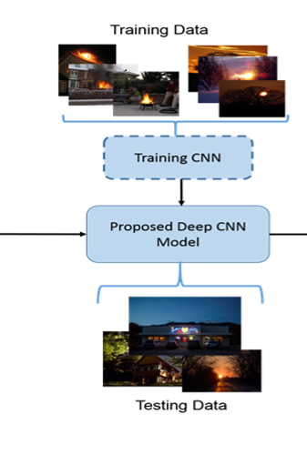
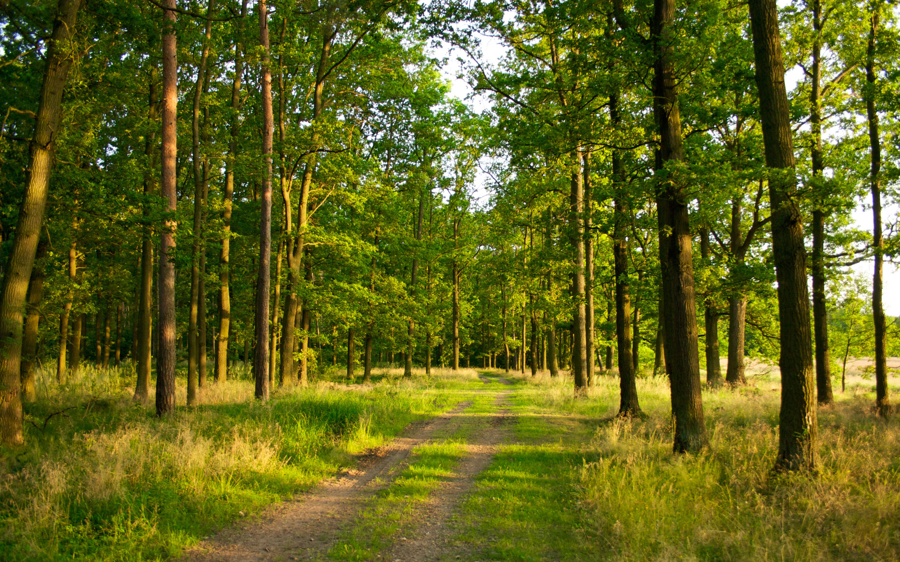
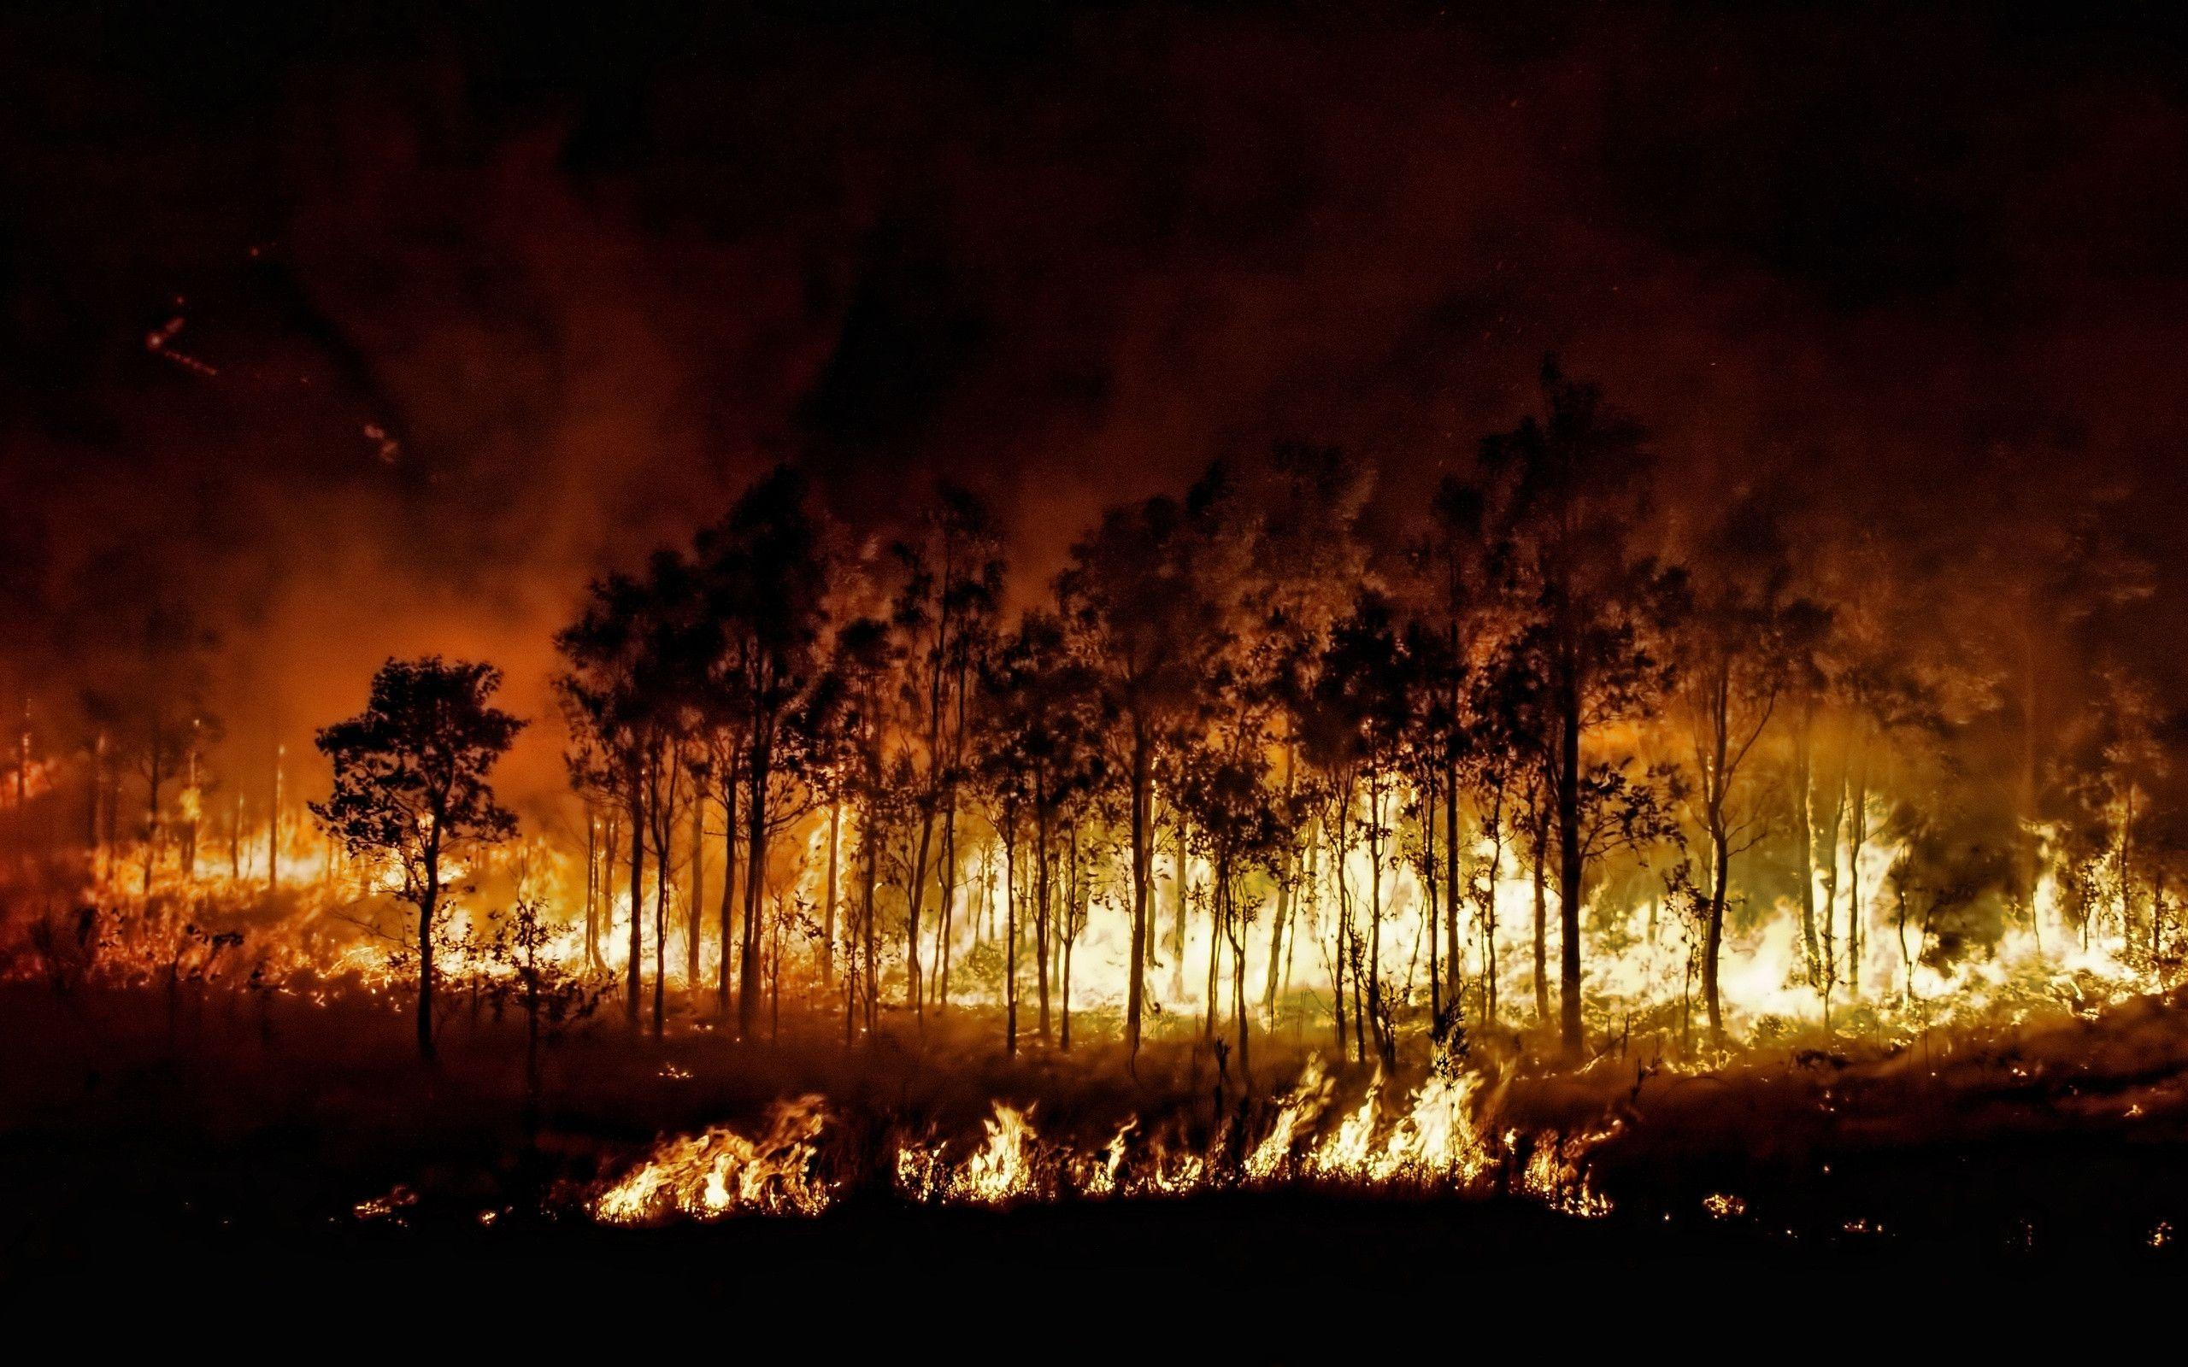
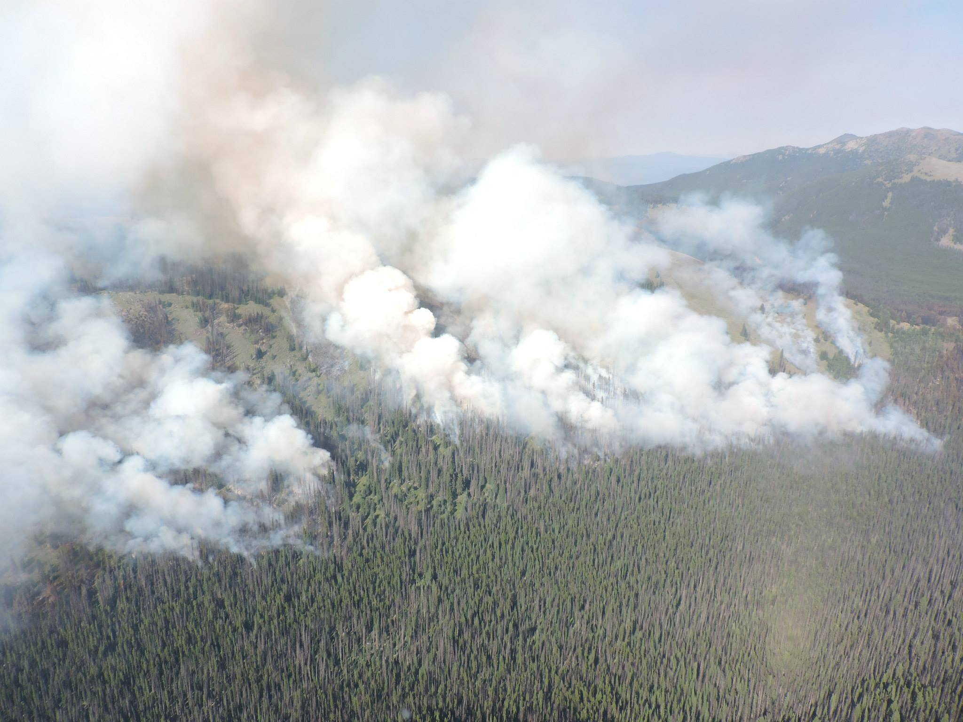
HOW IS IT DONE ?
NO FIRE
FIRE
FIRE START

Slide 4
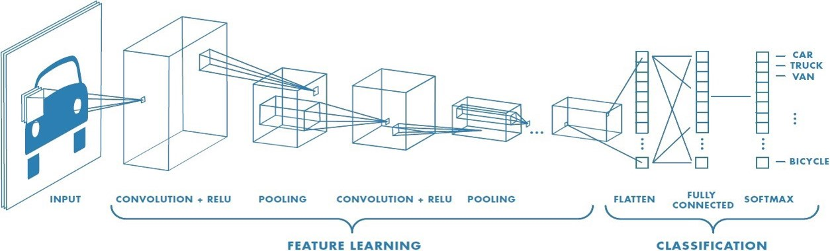
ALGORITHM
Convolutional Neural Network (ConvNet/CNN) is a Deep Learning algorithm which can take in an input image, assign importance (learnable weights and biases) to various aspects/objects in the image and be able to differentiate one from the other.

Slide 5
DATASET
Dataset
Provided dataset
Our network is trained on a provided dataset which contains images of three categories : 'fire', 'no fire', 'start fire’ count of almost 600 images and videos.
Augmenting the dataset
We will use data augmentation functions provided by Keras to perform a series of random transformation

Slide 6
GOALS
Improvement accuracy on Data Augmentation to get a better output.
Deep analysis of different phases of images.
Make use of the CNN model which has important practical application value for forest fire prevention planning and forest management.
Fire detection helps to save our bio-diversity

Slide 7
REQUIREMENTS SPECIFICATION
Hardware Requirements
Processor : Intel's i5
Hard Disk : 20GB
Memory : 2GB
Software Requirements
Language : Python
Editor : Jupyter notebook, Anaconda
Operating System : MS-Windows 10/ Linux

Slide 8
REFERENCES
Python: Automate the boring stuff with python by AI Sweigart. (BOOK)
https://www.w3schools.com/python/python_ml_data_distribution. (Tutorial)

Slide 9
Thank You!

